Slide 1
Software Project Management
Ch # 6: Software Requirements

Slide 2
Requirements Elicitation
Requirements elicitation is the process through which a requirements analyst gathers, understands, reviews, and articulates the needs of the software project’s stakeholders and users.
Elicitation involves fact-finding, validating one’s understanding of the information gathered, and communicating open issues for resolution.

Slide 3
Elicitation activities
Elicitation activities can include:
Interviews with the users, stakeholders, and anyone else whose perspective needs to be taken into account during the design, development, and testing of the software
Observation of the users at work
Distribution of discussion summaries to verify the data gathered in interviews

Slide 4
Continue…
The requirements engineering activities should wait until after the vision and scope document is ready
A variety of elicitation practices can be used to gain a complete understanding of user needs.
Each practice should be considered carefully, to determine which is best suited for a particular project; in addition, several techniques can be used in combination.

Slide 5
Conduct Interviews
The goal of the interview is to identify specific needs that the person being interviewed has for the software.
The first step in conducting interviews is to identify who the interviewees should be.
Start with the list of users and stakeholders listed in the vision and scope document.
The most important rule of the interview is to get the interviewee talking.
When there are multiple people with similar job functions or expertise, it is often helpful to interview them in groups

Slide 6
Continue…
After an initial set of interviews, a requirements analyst should follow up with meetings to verify his or her notes and to gather any new information that the interviewees may have come up with.
These meetings may consist of additional interviews, ad-hoc meetings with one or more people, brainstorming sessions, or other kinds of interactions.

Slide 7
Observe Users at Work
Observing a user’s workflow in the context of his or her environment allows a requirements analyst to see problems
that the user encounters with the current system and to identify ways to enhance and streamline the behavior of the software
Most software is built to help users with a job that they already do

Slide 8
Continue…
Once the requirements analyst has identified people who will use the software and whose day-to-day work is relevant to the behavior of the software, it is useful to observe those people at their jobs.

Slide 9
Use a Discussion Summary
The requirements analyst should capture this information as accurately as possible.
Once all of the information has been gathered from the elicitation activities, the requirements analyst should use a discussion summary to validate the information.
This will help catch any potential defects before they make it into the requirements documentation

Slide 10
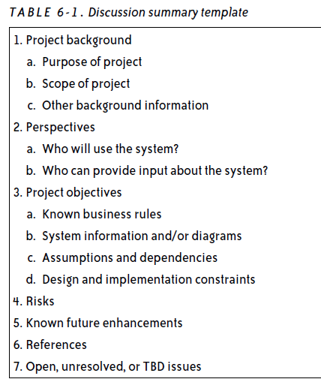

Slide 11
Use Cases
A use case is a description of a specific interaction that a user may have with the software.
Use cases are deceptively simple tools for describing the behavior of the software
A use case contains a textual description of all of the ways that the intended users could work with the software through its interface.

Slide 12
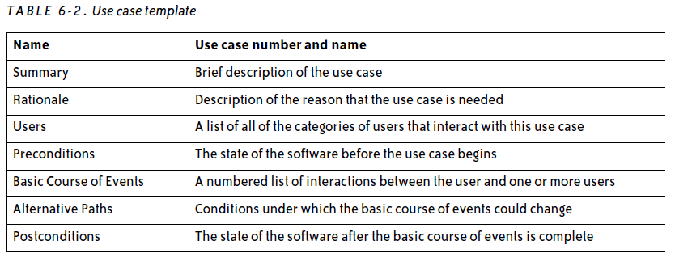

Slide 13
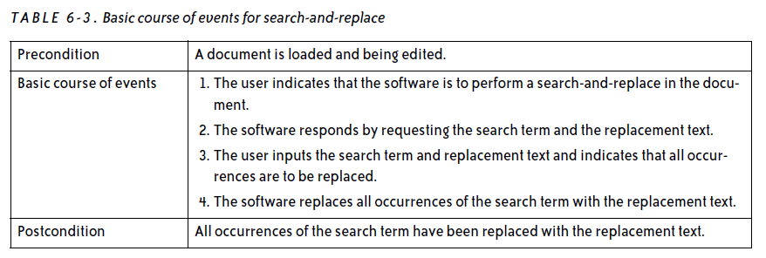
Basic Course of Events

Slide 14
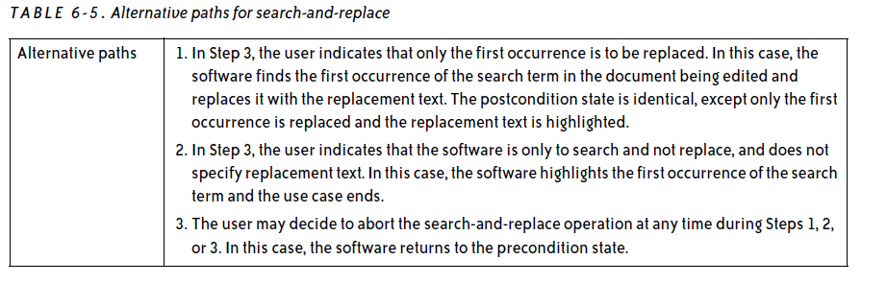
Alternative paths

Slide 15
